Slide 1


K.RAMAKRISHNAN COLLEGE OF TECHNOLOGY (AUTONOMOUS), TRICHY
RECOMMENDER SYSTEM FOR ONLINE COURSES
PRESENTED BY:
V.RANJANI (2303811714822037)

Slide 2


PRESENTATION OVERVIEW
Problem Identification
Objective
Proposed System
Block diagram for proposed system
Machine Learning Technique Used
Modules
Module Implementation
Module Description
Source Code
Screenshot
Conclusion and Future Enhancement

Slide 3
PROBLEM IDENTIFICATION
Multi-Language and Regional Preferences
Problem: Users from different regions might prefer courses in specific languages or formats tailored to local contexts.
Cross-Domain Preferences
Problem: Users might explore courses across different domains (e.g., technology, arts, business).
Dynamic Content Updates
Problem: New courses are frequently added, and existing courses are updated or deprecated.

Slide 4
PROBLEM IDENTIFICATION
Personalization
Provide recommendations tailored to individual users based on their:
Learning goals (e.g., upskilling, hobby learning, career development).
Preferences (e.g., course format, length, or difficulty level).
Historical interactions (e.g., enrolled courses, completed courses, ratings).
Addressing Cold Start
Effectively recommend courses to:
New users with minimal interaction data.
New courses with limited feedback.

Slide 5
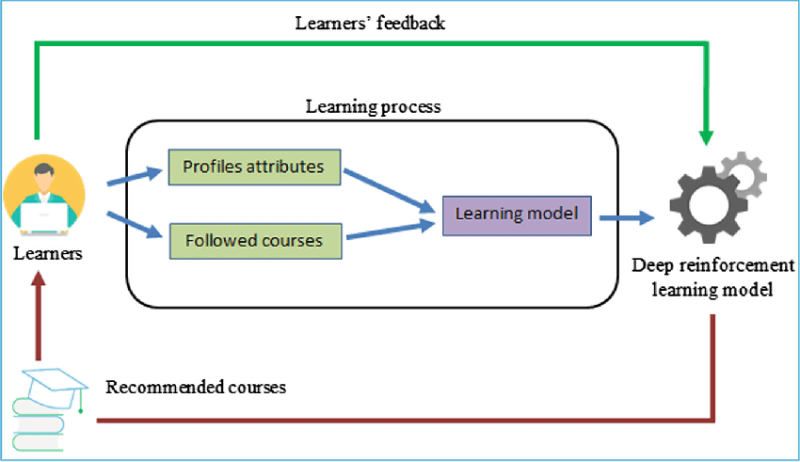
BLOCK DIAGRAM

Slide 6
MACHINE LEARNING TECHNIQUE USED
Deep Learning Models
Description: Leverages neural networks to learn complex relationships in user-item data.
Techniques:
Autoencoders: For dimensionality reduction and learning latent features.
Recurrent Neural Networks (RNNs): For sequence-based recommendations.
Convolutional Neural Networks (CNNs): To analyze images or videos related to course content.
Transformers: For contextualized and sequence-aware recommendations.
Applications:
Personalized recommendations based on user behavior history.
Limitations:
Requires significant computational resources and large datasets

Slide 7
MODULES
Content Based Filtering
Collaborative Filtering

Slide 8
Module Implementation
a. Collaborative Filtering
Collaborative filtering makes recommendations based on past user behavior, assuming that if two users have rated or interacted with similar courses, they will like each other's courses in the future.
User-Collaborative Filtering: Find users who are similar to a target user and recommend courses they liked.
b. Content-Based Filtering
Content-based filtering uses the attributes of the courses (such as category, difficulty, description) and the user's previous interactions with those courses to make recommendations.
Steps:
Extract features from the course descriptions, categories, etc.
Compute similarity scores based on these features.
Recommend courses with high similarity to the courses the user has interacted

Slide 9
Module Description
The Course Recommender System for Machine Learning (ML) is designed to provide personalized course recommendations to users based on their learning interests, preferences, and past behaviors. This system can be used by online education platforms to recommend Machine Learning (ML) and related courses to users based on collaborative filtering, content-based filtering, and hybrid models.
This recommender system employs advanced machine learning techniques such as collaborative filtering, content-based filtering, and matrix factorization to make course recommendations tailored to each user's learning journey. By utilizing these methods, the system improves user engagement, aids in course discovery, and optimizes learning paths for students interested in Machine Learning topics.

Slide 10
Source Code
import pandas as pd
import numpy as np
from sklearn.neighbors import NearestNeighbors
from sklearn.preprocessing import LabelEncoder
# Step 1: Data Collection
# Sample data of User, Course, Rating
data = {
'User': ['Alice', 'Bob', 'Charlie', 'David', 'Eve', 'Alice', 'Bob', 'Charlie', 'David', 'Eve'],
'Course': ['Python Basics', 'Python Basics', 'Python Basics', 'Python Basics', 'Python Basics',
'Machine Learning', 'Machine Learning', 'Machine Learning', 'Machine Learning', 'Machine Learning'],
'Rating': [4, 5, 5, 3, 4, 3, 4, 5, 2, 4]
}
# Convert to DataFrame
df = pd.DataFrame(data)
# Step 2: Data Preprocessing
# Create a matrix where rows represent users and columns represent courses
user_course_matrix = df.pivot_table(index='User', columns='Course', values='Rating')
# Fill NaN values with 0 (since a missing rating indicates no interaction)
user_course_matrix = user_course_matrix.fillna(0)
# Step 3: Label Encoding for Users and Courses (if needed for scaling)
user_encoder = LabelEncoder()
course_encoder = LabelEncoder()
# Transform users and courses into numeric values
user_course_matrix_encoded = user_course_matrix.copy()
user_course_matrix_encoded.index = user_encoder.fit_transform(user_course_matrix.index)
user_course_matrix_encoded.columns = course_encoder.fit_transform(user_course_matrix.columns)
# Step 4: Model - KNN for Collaborative Filtering (User-Based)
# Using NearestNeighbors for finding similar users based on ratings
knn = NearestNeighbors(metric='cosine', algorithm='brute', n_neighbors=3)
knn.fit(user_course_matrix_encoded)
# Step 5: Make Recommendations (Example: for Alice)
# Get Alice's encoded index
alice_index = user_encoder.transform(['Alice'])[0]
# Find similar users
distances, indices = knn.kneighbors(user_course_matrix_encoded.iloc[alice_index, :].values.reshape(1, -1))
# Step 6: Display Recommendations
# Get the similar users' indices and map back to user names
similar_users = user_encoder.inverse_transform(indices.flatten())
print(f"Users similar to Alice: {similar_users}")
print("\nRecommended courses based on similar users:")

Slide 11
# Find courses that Alice has not rated yet and recommend those
recommended_courses = set()
for similar_user in similar_users:
if similar_user != 'Alice':
similar_user_courses = user_course_matrix.loc[similar_user]
# Recommend courses that have a high rating (greater than 3) and Alice hasn't rated yet
for course, rating in similar_user_courses.items():
if rating > 3 and user_course_matrix.loc['Alice', course] == 0:
recommended_courses.add(course)
# Display the recommended courses
print(recommended_courses)

Slide 12
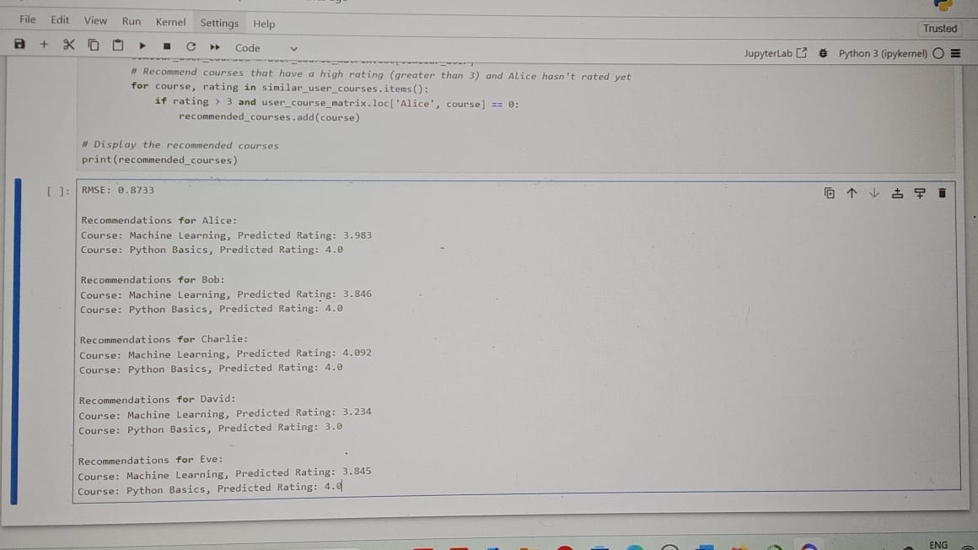
Screenshot

Slide 13
Conclusion and Future Enhancement
The Recommender System for Online Courses in Machine Learning (ML) provides personalized, relevant course suggestions based on user preferences, past behavior, and the content of the courses themselves. By utilizing a combination of Collaborative Filtering, Content-Based Filtering, and Hybrid Approaches, the system can effectively recommend courses tailored to the specific learning journey of users, from beginners to advanced learners in the field of machine learning.
Neural Collaborative Filtering (NCF) and Autoencoders could be used for more sophisticated collaborative filtering approaches. These deep learning models can learn complex latent factors in user-course interactions and produce more accurate predictions for course recommendations.

Slide 14
THANK YOU

